Slide 1
INDIAN GENERAL ELECTION ANALYSIS AND STRATEGIES
TEAM NUMBER : 15
NAME:RITHESH RAJ (232BDA39)
ALPHONSE ROSE PHILIP(232BDA40)

Slide 2
INTRODUCTION :
Analyzing and Identifying Strategies for the Lok Sabha Elections
Aim to Achieve the Desired Margins for Any Political Party
Examining Election Results from 1996 to 2019
Visualizing Election Strategies
Incorporating Machine Learning Techniques in Analysis
Developing a User-Friendly Interface"

Slide 3
SOURCE :
DataSet :https://eci.gov.in/
Machine learning and EDA : https://openai.com/chatgpt and https://www.bing.com/chatbot
Application Used: Project Jupyter | Home and https://visualstudio.microsoft.com/downloads/
Packages used : pandas ,numpy , matplotlib ,openpyxl
Machine Learning Algorithm : K-Means Clustering
Web Frame Work : https://flask.palletsprojects.com/en/3.0.x/
Mark Up Language : Html
UserInterface: To check all information about each constituency on particular year

Slide 4
DATASET DETAILS :
State: The state where the electoral contest took place.
Constituency: The specific geographic area or constituency within the state.
Caste Category: The caste category of the candidates, which can be a factor in Indian politics.
Winner: The name of the winning candidate.
Winner_Political_Party: The political party to which the winning candidate belongs.
Winner_Votes: The number of votes received by the winning candidate.
RunnerUp: The name of the candidate who finished second in the election.
RunnerUp_Political_Party: The political party of the runner-up candidate.
RunnerUp_Votes: The number of votes received by the runner-up candidate.
Margin_Winner_VS_RunnerUp_Votes: The difference in votes between the winner and the runner-up, indicating the margin of victory.
Others_Votes: The number of votes received by other candidates who did not win or come in second place.
Total_Votes_Pooled: The total number of votes cast in the election.
Total_Electors: The total number of eligible voters or electors in the constituency.
Margin_Percentage: The margin of victory expressed as a percentage of the total votes cast.
Religion_won: The religious background or affiliation of the winning candidate.
Year: The year in which the election took place.

Slide 5
KEY POINTS OF STRATEGIES :
1.Determine the political PARTY that secured the most SEATS in the previous 7 elections.
2.Conduct a CHI-SQUARED test to analyze the relationship between RELIGION and the WINNING POLITICAL PARTY.
3.Examine the dominant RELIGION that emerged victorious in each CONSTITUENCY for each term and calculate the overall PERCENTAGE distribution of religions.
4.Investigate the CASTE category distribution in every constituency.
5.Analyze the number of seats won by BJP and the INC within each CASTE category.
6.Count the winners from BJP and INC in each RELIGION category.
7.Identify the CONSTITUENCY with the lowest PERCENTAGE of votes cast.

Slide 6
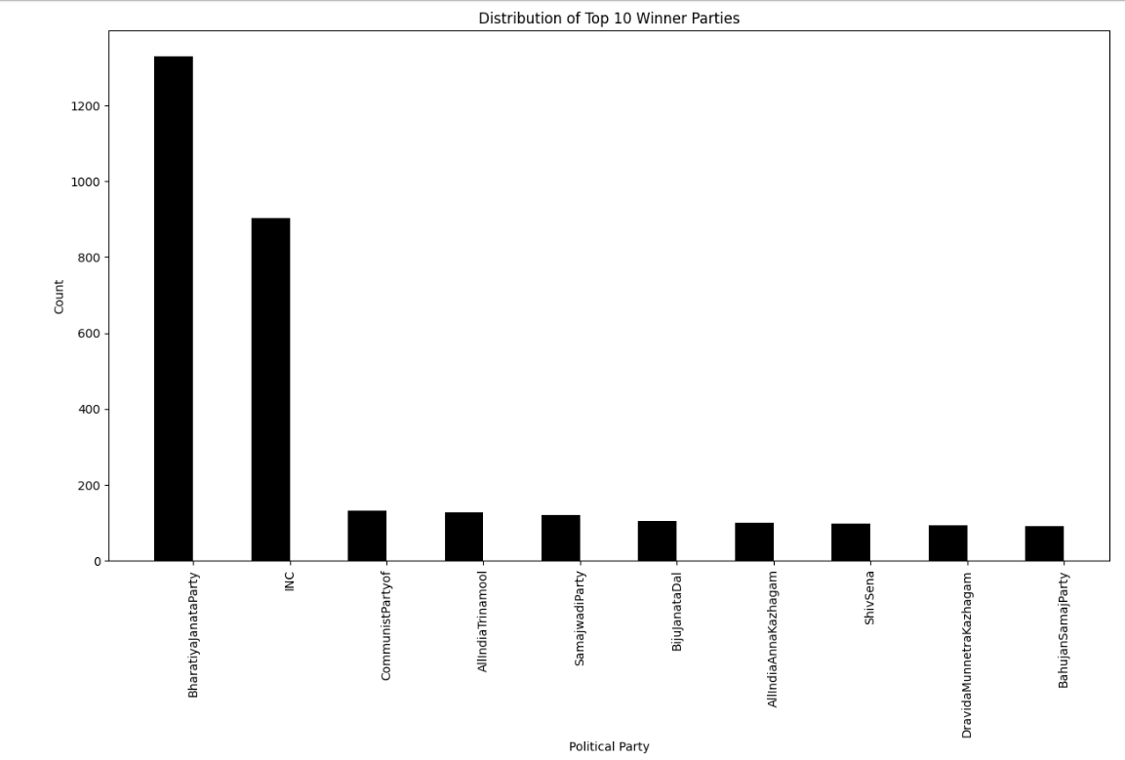
DISTRIBUTION OF WINNER
SUMMARY :
Bharatiya Janata Party (BJP) has the highest count of approximately 1200.
Indian National Congress (INC) follows with a count of approximately 800.
The remaining parties have counts below 200.
This suggests that the BJP and INC were the most dominant parties in the election, while the other parties had a marginal presence.

Slide 7
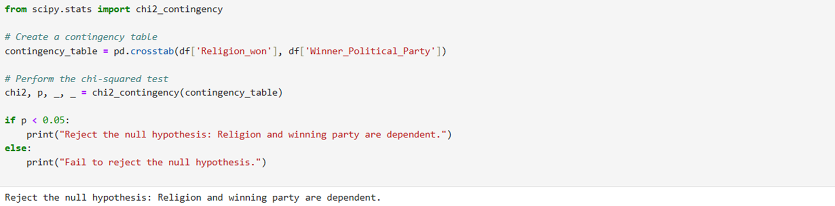
Perform the chi-squared test on religion and winning political party :
The result of your chi-squared test indicates that you "reject the null hypothesis." In statistical terms, this means that there is enough evidence to conclude that religion and the winning political party are dependent variables in your dataset.

Slide 8
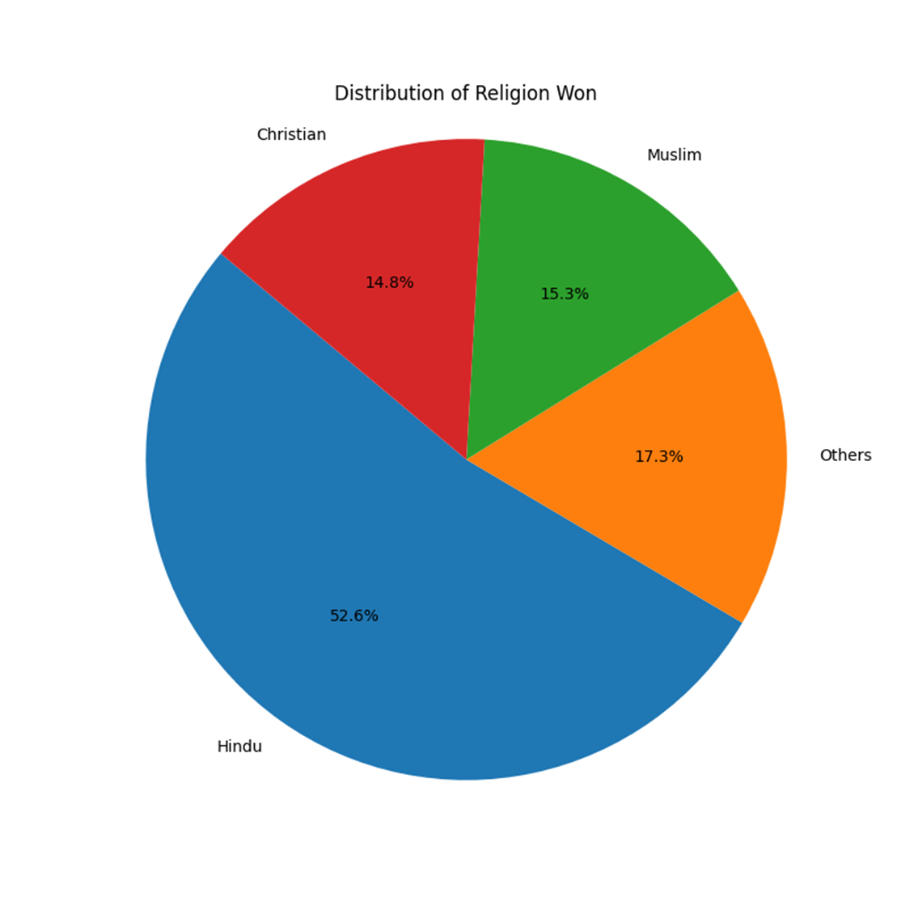
PIE CHART OF DISTRIBUTION OF RELIGION WON
SUMMARY :
The chart is divided into four sections: Hindu, Others, Muslim, and Christian.
The largest section is Hindu, which takes up 52.6% of the chart.
The second largest section is Others, which takes up 17.3% of the chart.
The third largest section is Muslim, which takes up 15.3% of the chart.
The smallest section is Christian, which takes up 14.8% of the chart.

Slide 9
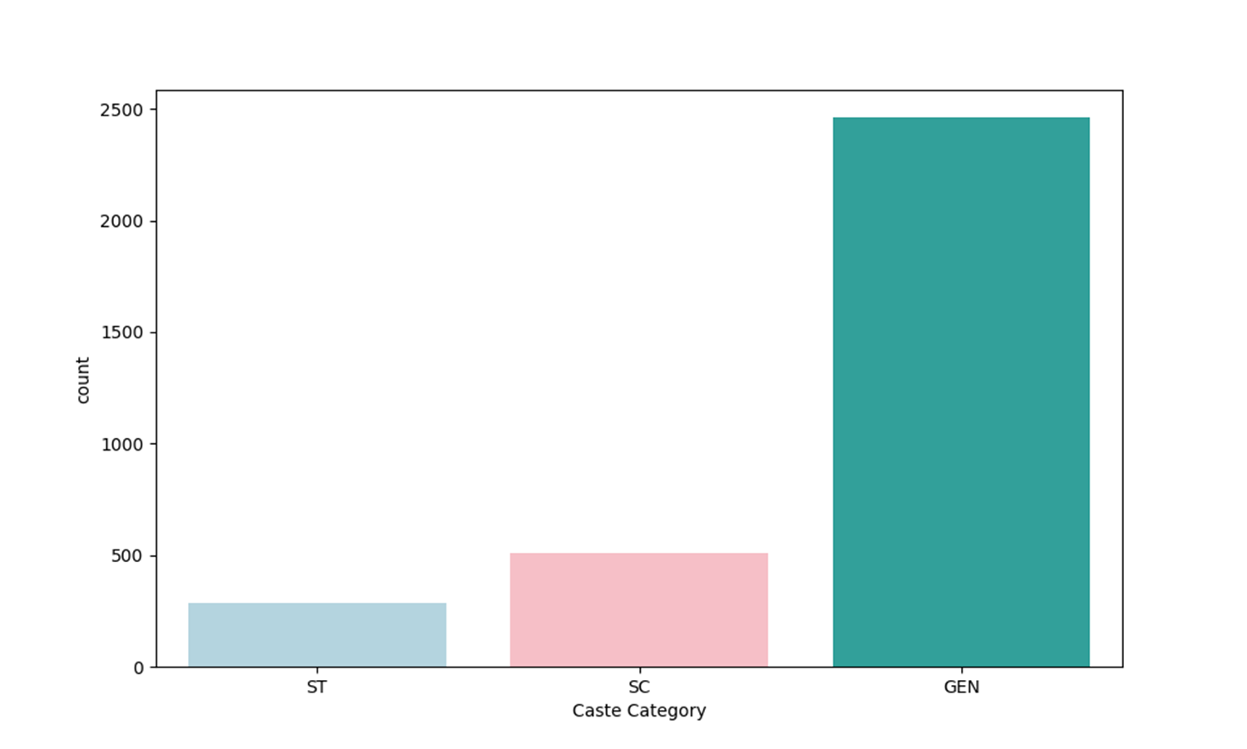
COUNT OF INDIVIDUALS IN THREE CASTE CATEGORIES
SUMMARY :
This is a bar chart with three bars representing three caste categories: ST, SC, and GEN.
The x-axis represents the caste categories and the y-axis represents the count of individuals.
The GEN category has the highest count, followed by SC and ST

Slide 10
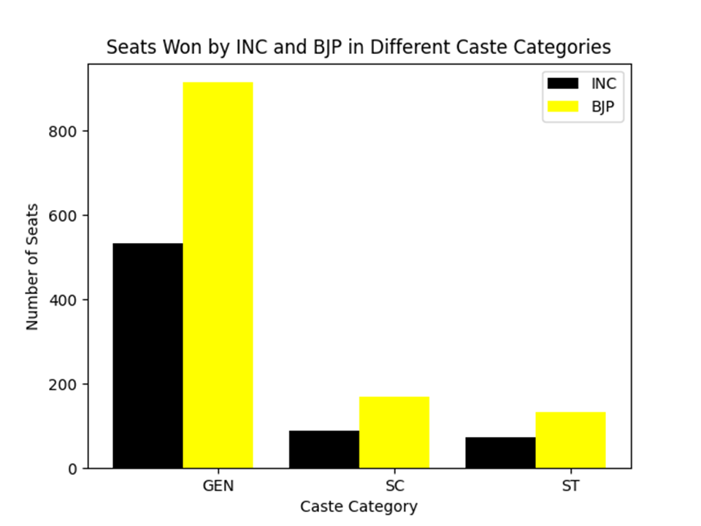
SEATS WON BY BJP AND INC IN CASTE CATEGORY
SUMMARY :
The bar chart shows the number of seats won by INC and BJP in different caste categoriesThis is a bar chart with three categories on the x-axis: GEN, SC, and ST.
. The conclusion is that BJP won more seats in the GEN and ST categories
While INC won more seats in the SC category.
The y-axis shows the number of seats won by the two parties, INC and BJP.
The bars are colored yellow for BJP and black for INC.

Slide 11
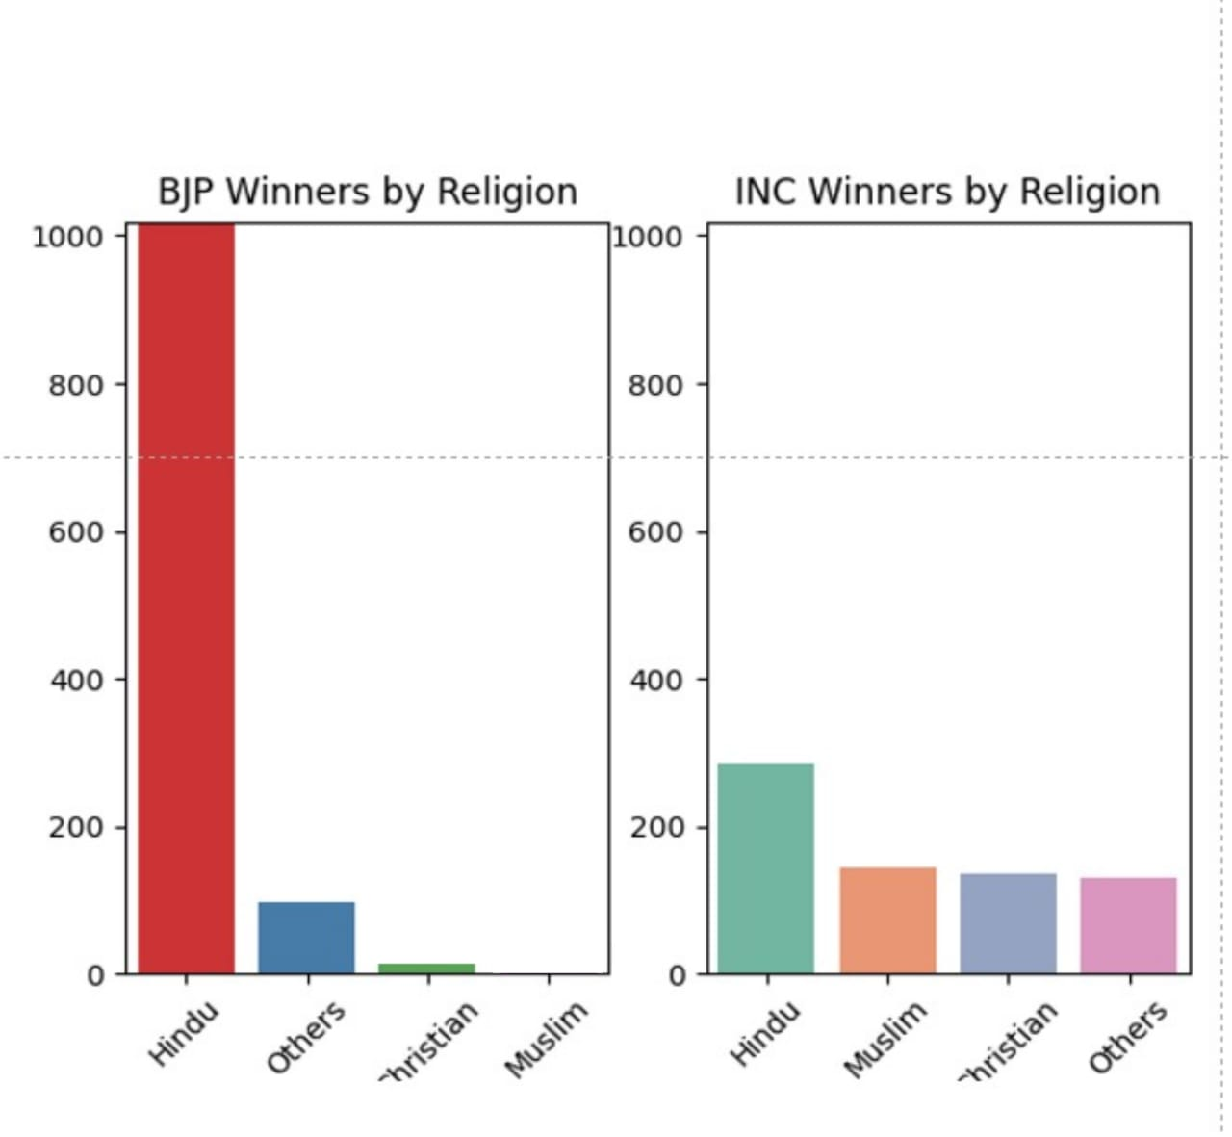
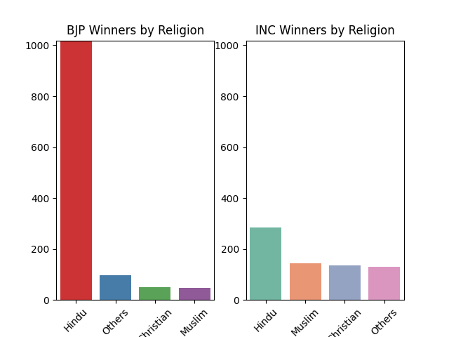
COUNT OF WINNERS IN BJP AND INC IN RELIGION CATEGORY
SUMMARY :
This is a bar chart comparing the number of winners from the BJP and INC parties by religion.
The chart is divided into two sections, one for the BJP party and one for the INC party.
The BJP party has a significantly higher number of Hindu winners, while the INC party has a more diverse distribution of winners by religion.
The BJP party has a small number of winners from other religions, including Christian and Muslim.
The INC party has a higher number of winners from Muslim and Christian religions, as well as a small number of winners from other religions.
Overall, it seems that the BJP party has a higher number of Hindu winners compared to the INC party. However, the INC party has a more diverse distribution of winners by religion.

Slide 12
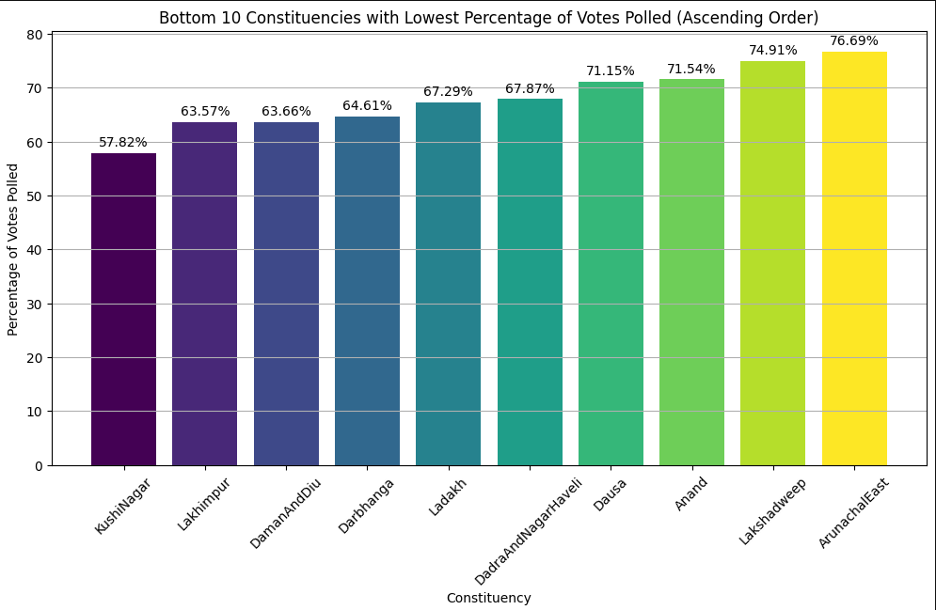
BOTTOM 10 CONSTITUENCY WITH LOWEST PERCENTAGE
OF VOTES POLLED
SUMMARY :
On the plot, the x-axis represents the constituency names, and the y-axis represents the corresponding percentage of votes polled. The lowest percentage of votes polled in the bottom 10 constituencies is 57.82% in Kushinagar.
The highest percentage of votes polled in the bottom 10 constituencies is 76.99% in Arunachaleast.
The bars in the bar plot are arranged in ascending order of percentage of votes polled.

Slide 13
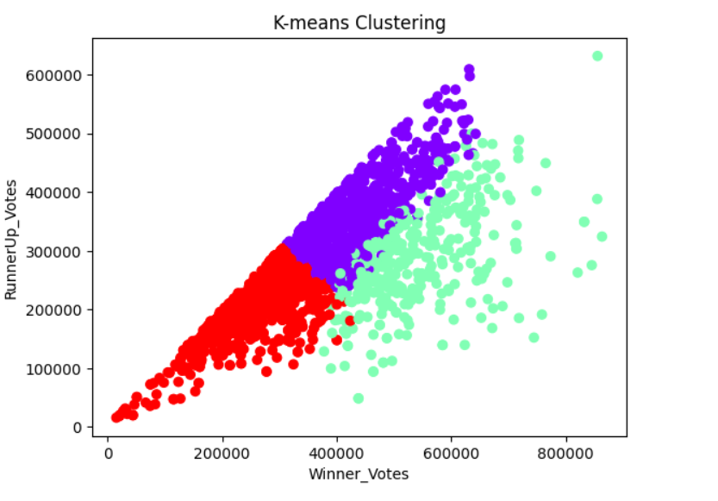
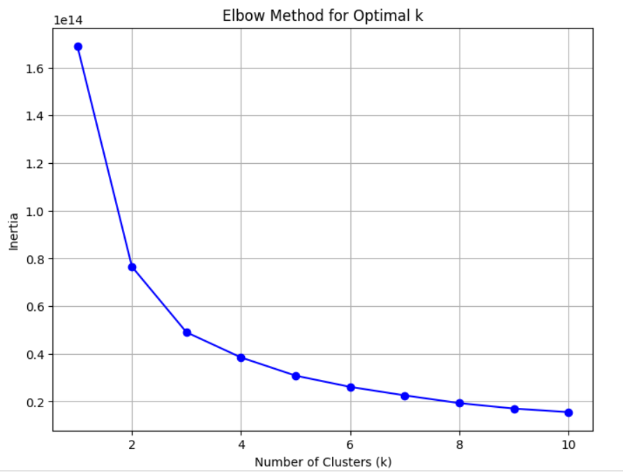
K-MEAN CLUSTERING
What is K-Means Clustering ?
K-means clustering is a machine learning algorithm used to group similar data points into clusters, with the goal of minimizing the within-cluster variance. It involves iteratively assigning data points to the nearest cluster centroids and updating the centroids until convergence.

Slide 14
USER INTERFACE :
Introduction: Our Constituency Information Retrieval System is a user-friendly and efficient interface that empowers users to access essential data related to constituencies and elections. By simply entering the Constituency name, users can instantly obtain comprehensive information, including the Winner Political Party, Winner Votes, Runner-Up Political Party, Runner-Up Votes, Margin Winner vs. Runner-Up Votes, Others Votes, Total Votes Polled, Total Electors, Margin Electors vs. Polled, and the Religion of the winning candidate. This tool is designed to provide a holistic view of the election scenario in a specific constituency.
LINK TO WEBSITE : http://127.0.0.1:5000/
Winner Political Party: This feature reveals the political party that secured victory in the selected constituency.
Winner Votes: Users can access the number of votes the winning candidate received.
Runner-Up Political Party: Find out the political party that stood second in the election.
Runner-Up Votes: Discover the number of votes received by the runner-up candidate.
Margin Winner vs. Runner-Up Votes: This crucial information highlights the difference in votes between the winning and runner-up candidates, indicating the competitiveness of the election.
Others Votes: Learn about the votes secured by candidates other than the winner and runner-up.
Total Votes Polled: Get insights into the overall voter turnout in the constituency.
Total Electors: Understand the total number of eligible voters in the selected constituency.
9.Margin Percentage : Users can quickly ascertain the margin percentage between the total votes polled and the total electors

Slide 15
THANK YOU

